Slide 1
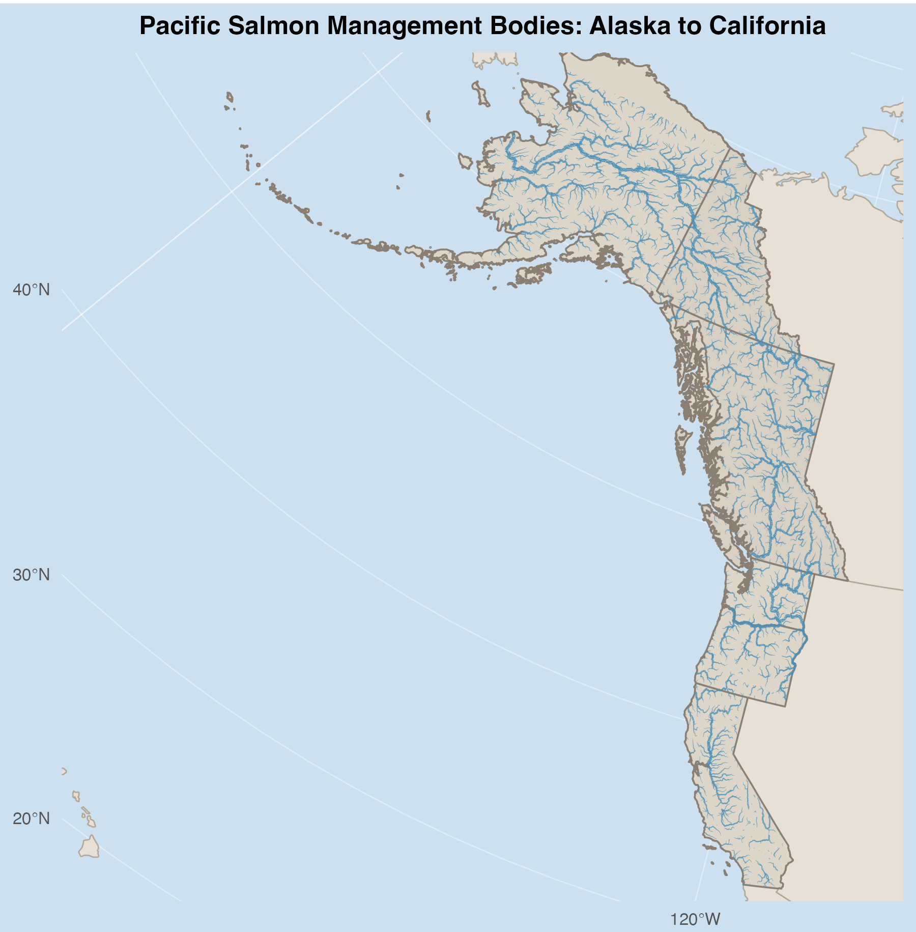
Alaska Regional: Board of Fish
Adjustment Scale: Annual
Transboundary: Pacific Salmon Treaty
Adjustment Scale: Decadal
BC/Yukon Regional: Canadian Pacific Region Salmon Integrated Fisheries Management Plan
Adjustment Scale: Annual
PNW Regional: Pacific Fishery Management Council
Adjustment Scale: Annual

